Slide 1
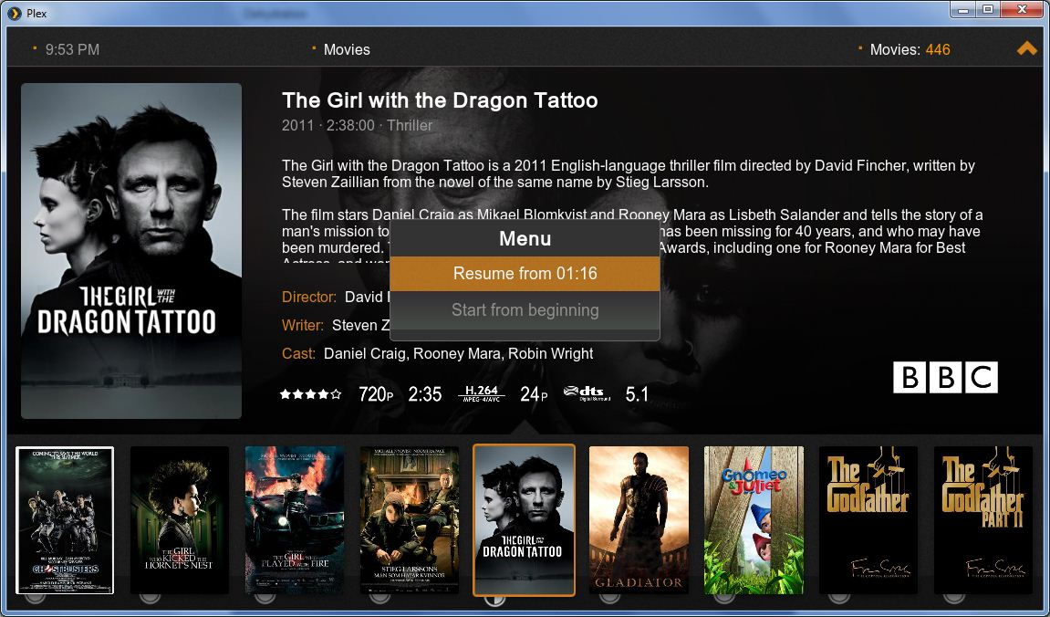

Slide 2
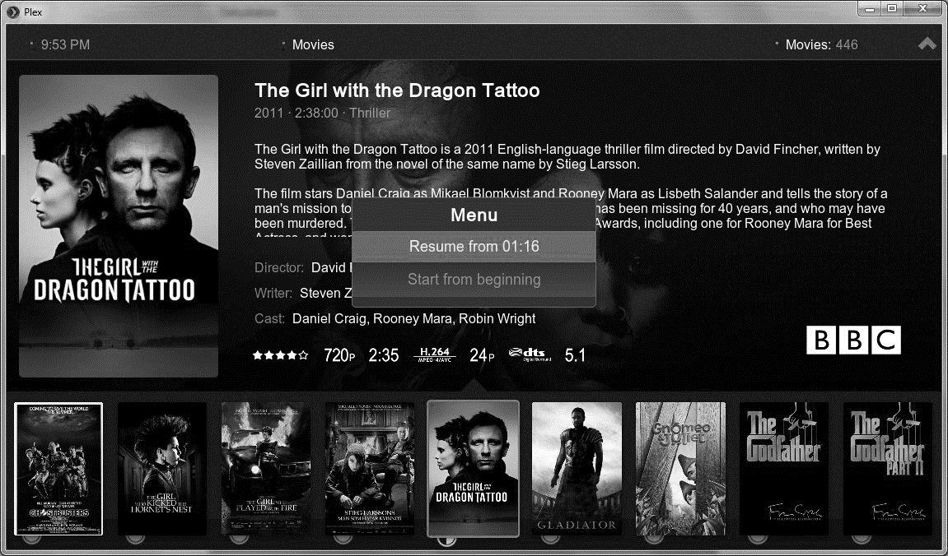
Reconfigure History.Dat Module to be feed a [TITLE], [ALTNAME], … for display of the information
Use the scrolling test animation module to scroll the information
[CLOCK]
GAMES: # / TOTAL
[FLYER]
[TITLE]
[YEAR] [MANUFACTUR]
[HISTORY.DAT] Info
[ESB RATING]
[WHEEL ART]
[PLAYERS]
[# PLAYED]
[GENRE]
[EMULATOR]
[TV]
[TV]
[TV]
Selected TV for Detail, add Border as a highlight
Genre and Emulator all designed by me to fit in a special size designed by me
!
All Detail area info is to use the fade module during transitions

Slide 3
History.dat code
https://github.com/mickelson/attract/blob/master/config/plugins/History.dat/plugin.nut
Using the fade module for artwork
fe.load_module( "fade" ); // fill an entire surface with our snap at a resolution of 480x360 // local surface = fe.add_surface( 480, 360 ); local snap = FadeArt( "snap", 0, 0, 480, 360, surface ); snap.preserve_aspect_ratio = true; // position and pinch the surface // surface.set_pos( 330, 80, 300, 250 ); surface.pinch_y = -80;
Using the scrolling text module for text
fe.load_module("objects/scrollingtext");
local scroller = ScrollingText.add( "[Title]", 25, 50, fe.layout.width - 25, 75, ScrollType.HORIZONTAL_LEFT );
//there is a couple wrapper functions for color:
scroller.set_rgb( 255, 0, 0 ); //the text color
scroller.set_bg_rgb( 0, 0, 0 ); //the surface color (uses a pixel.png to color the surface)
//scroller.set_pos( 0, 0, 100, 100 ); //the surface x, y, w, h
//you can access the surface and text objects directly
//scroller.surface <- the surface
//scroller.text <- the text object
//There are also some settings:
scroller.settings.delay = 500;
scroller.settings.loop = -1;

Slide 4
///////////////////////////////////////////////////
//
// Attract-Mode Frontend - Use History.dat plugin
//
//
// This plugin will allow you to load the History.
// dat data for a given game into a text object.
//
// Based upon the history.dat plugin and altered
// to allow showing the data in a layout instead
// of having to press a button
// The original History.dat plugin needs to be
// configured for this to work
///////////////////////////////////////////////////
//
// Load our history.dat file utilities
//
local my_dir = fe.script_dir;
dofile( my_dir + "file_util.nut" );
local config=fe.get_config();
class LoadHistory
{
m_text = "";
m_curr_rom = "";
function loadtext()
{
local sys = split( fe.game_info( Info.System ), ";" );
local rom = fe.game_info( Info.Name );
//
// we only go to the trouble of loading the entry if
// it is not already currently loaded
//
if ( m_curr_rom != rom )
{
m_curr_rom = rom;
local alt = fe.game_info( Info.AltRomname );
local cloneof = fe.game_info( Info.CloneOf );
local lookup = get_history_offset( sys, rom, alt, cloneof );
if ( lookup >= 0 )
{
m_text.msg = get_history_entry( lookup, config );
}
else
{
if ( lookup == -2 )
m_text.msg = "Index file not found. Try generating an index from the history.dat plug-in configuration menu.";
else
m_text.msg = "Unable to locate: "
+ rom;
}
}
}
}

